Slide 1

Project phase B
24-1-R-19
Wildfire segmentation based on Yolo and attention U-Net
supervisor:
prof. Miri Weiss Cohen
students:
Avner Ben Shlomo
Dor Filis

Slide 2
Agenda
Introduction - Wildfire
Motivation
YOLOv4
Segmentation
Attention UNET
Proposed approach
Challenges
Dataset
Results
Conclusions

Slide 3
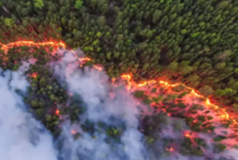
Introduction - Wildfire
Wildfires devastate communities, farmlands, and animal habitats worldwide.
Increased frequency attributed to global warming rising temperatures.
current solutions:
Sensor and Long-Range Camera Systems
Ground-Based Sensor Systems
Sound-Based Technologies
Floating Devices (Balloons or Spheres)
Notes:
The effects are not just local but can have far-reaching consequences on ecosystems and economies."
we're seeing longer dry seasons, and today citation with the war factors that contribute to more frequent and intense wildfires
sensors to monitor large areas of land." These systems can be expensive to implement and maintain, They may also generate false alarms due to dust, fog, or other atmospheric conditions that mimic smoke."
networks of sensors placed throughout high-risk areas. The effectiveness of these systems can be limited by the density of sensor placement. it may be challenging and costly to deploy and maintain a sufficient number of sensors."
coustic sensors to detect the specific sounds associated with fire." hese systems may have difficulty distinguishing between fire sounds and other similar noises in the environmen
These are mobile platforms equipped with cameras or sensors." These devices are at the mercy of weather conditions. Strong winds or storms can push them off course or damage them.

Slide 4
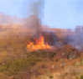
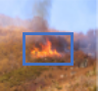
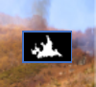
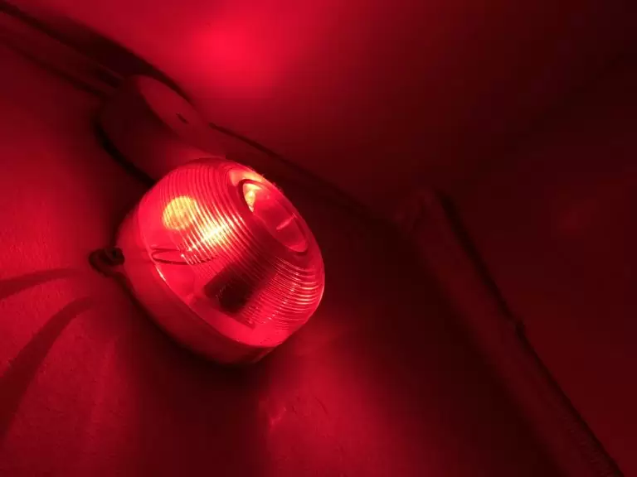
Motivation
"Early wildfire detection:
essential protection."

Slide 5
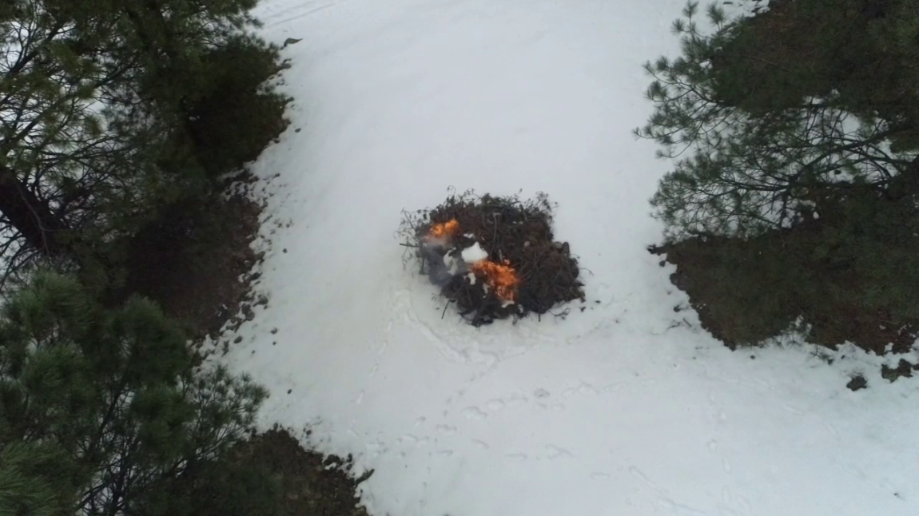
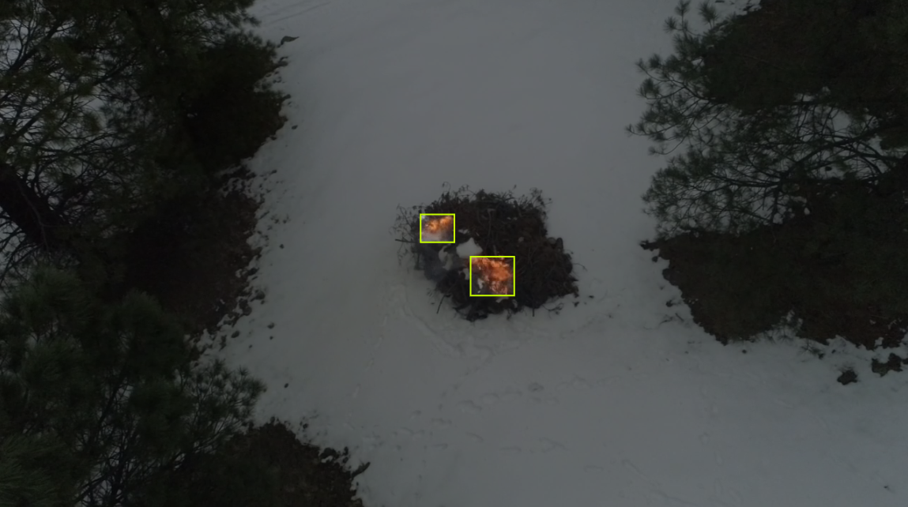
YOLO
YOLO (You Only Look Once) is an object detection deep learning model , initially developed by Joseph Redmon and Ali Farhadi in 2015.
Since its inception, there have been eight different versions, with the latest being YOLO V8 released in 2023

Slide 6
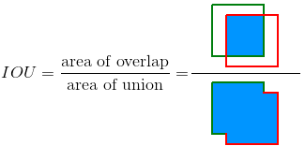

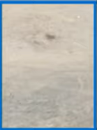
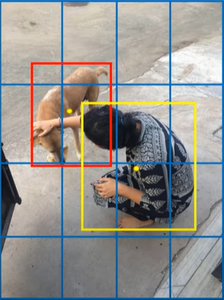
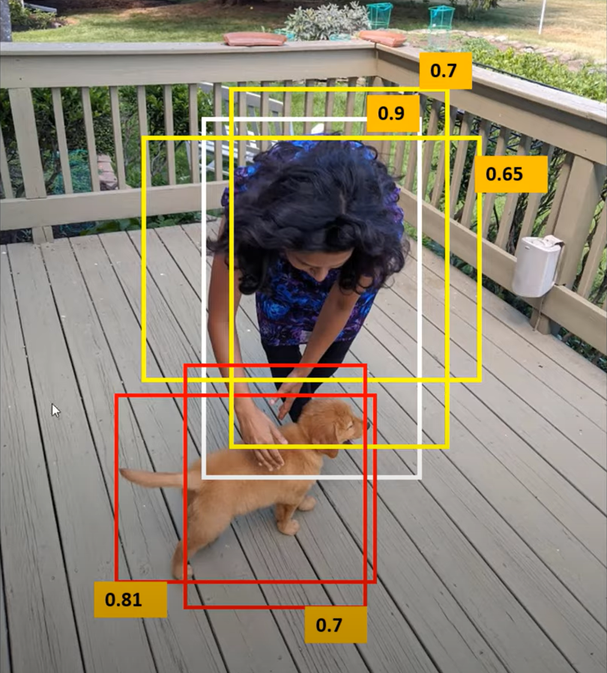
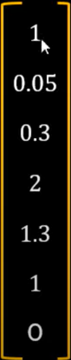
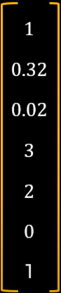
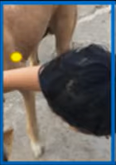
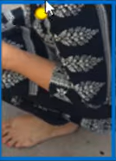
How YOLO works?

Slide 7
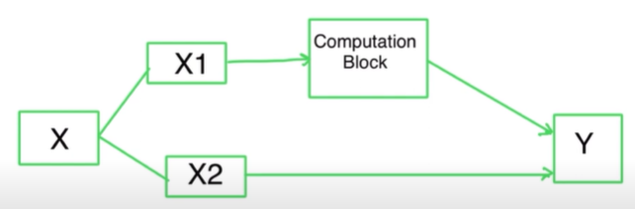
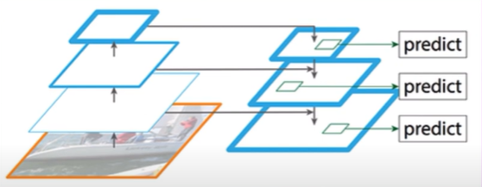
YOLOv4
Input
Backbone - CSPDarkNet53
Used for feature extraction
Neck
Collect feature maps from different stages
Head - YOLO
Notes:
darknet 53 was used in v3 and it just 53 layers of cinv blocks and dense blocks.
as we go throw the backbone we get more semantic info and less spatial info and for the object detection we need both. so instead of go and do prdediction in the backbone that the fm are independent we do something similar to encoder decoder and create combination between hig level feature map and loe and we get new set of festures

Slide 8
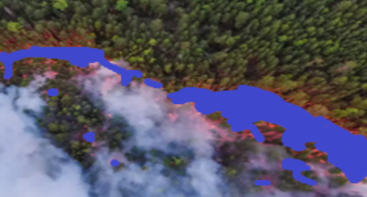
Segmentation
A Process of labeling each pixel of an image with a corresponding class.

Slide 9
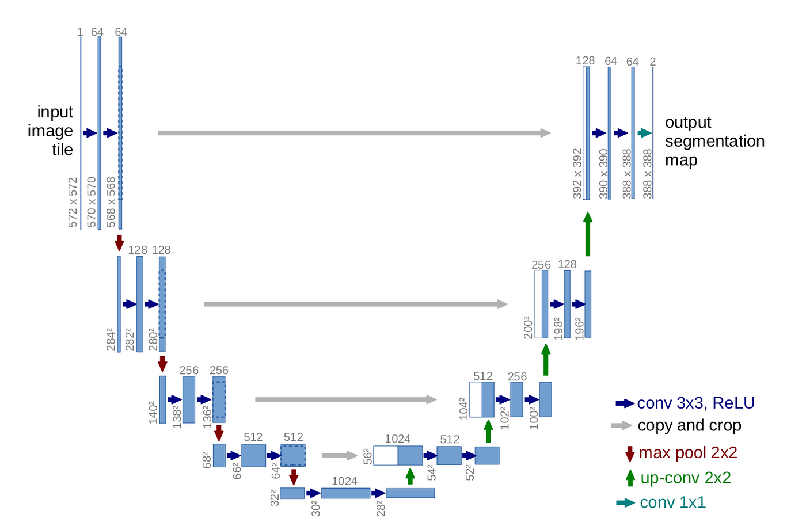
UNET
Design: U-shaped architecture
Downsample Blocks:
Capture features at different levels by reducing image size.
Upsample Blocks:
Restore image size while combining features from downsample blocks.

Slide 10
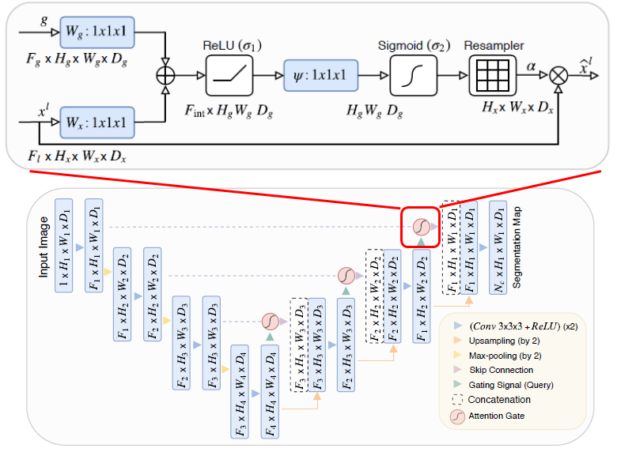
Attention UNET
Attention Blocks:
Focus on the most important features, improving accuracy.

Slide 11
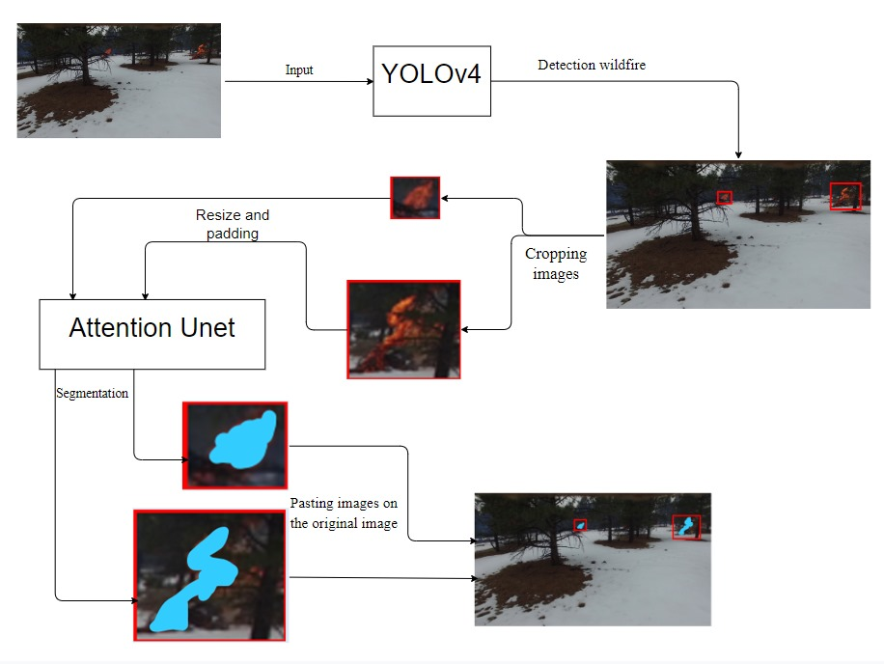
Proposed approach:

Slide 12
Challenges
Challenges in Environment Setup:
Limited hardware led to using Google Colab Pro Plus for access to 83.5 GB RAM, 40 GB GPU RAM, and cloud datasets.
Dataset Challenges:
Initial dataset had images with minimal fire, which hindered learning.
Resolved by cropping and resizing fire areas to 320x320, padding where needed.
Model Training Issues:
YOLOv4 struggled with class prediction errors (average IOU of 0.74).
Attention U-Net: Training difficulties due to fire occupying small parts of the image.
Pipeline Challenges:
Integrating YOLOv4 and Attention U-Net for seamless detection and segmentation.
Initial segmentation results were poor, requiring dataset augmentation using the mosaic method for improvement.

Slide 13
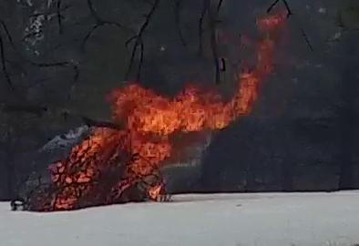
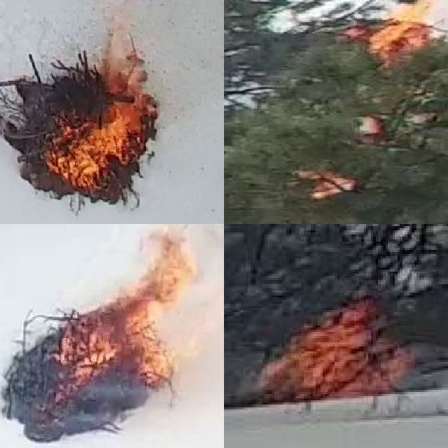
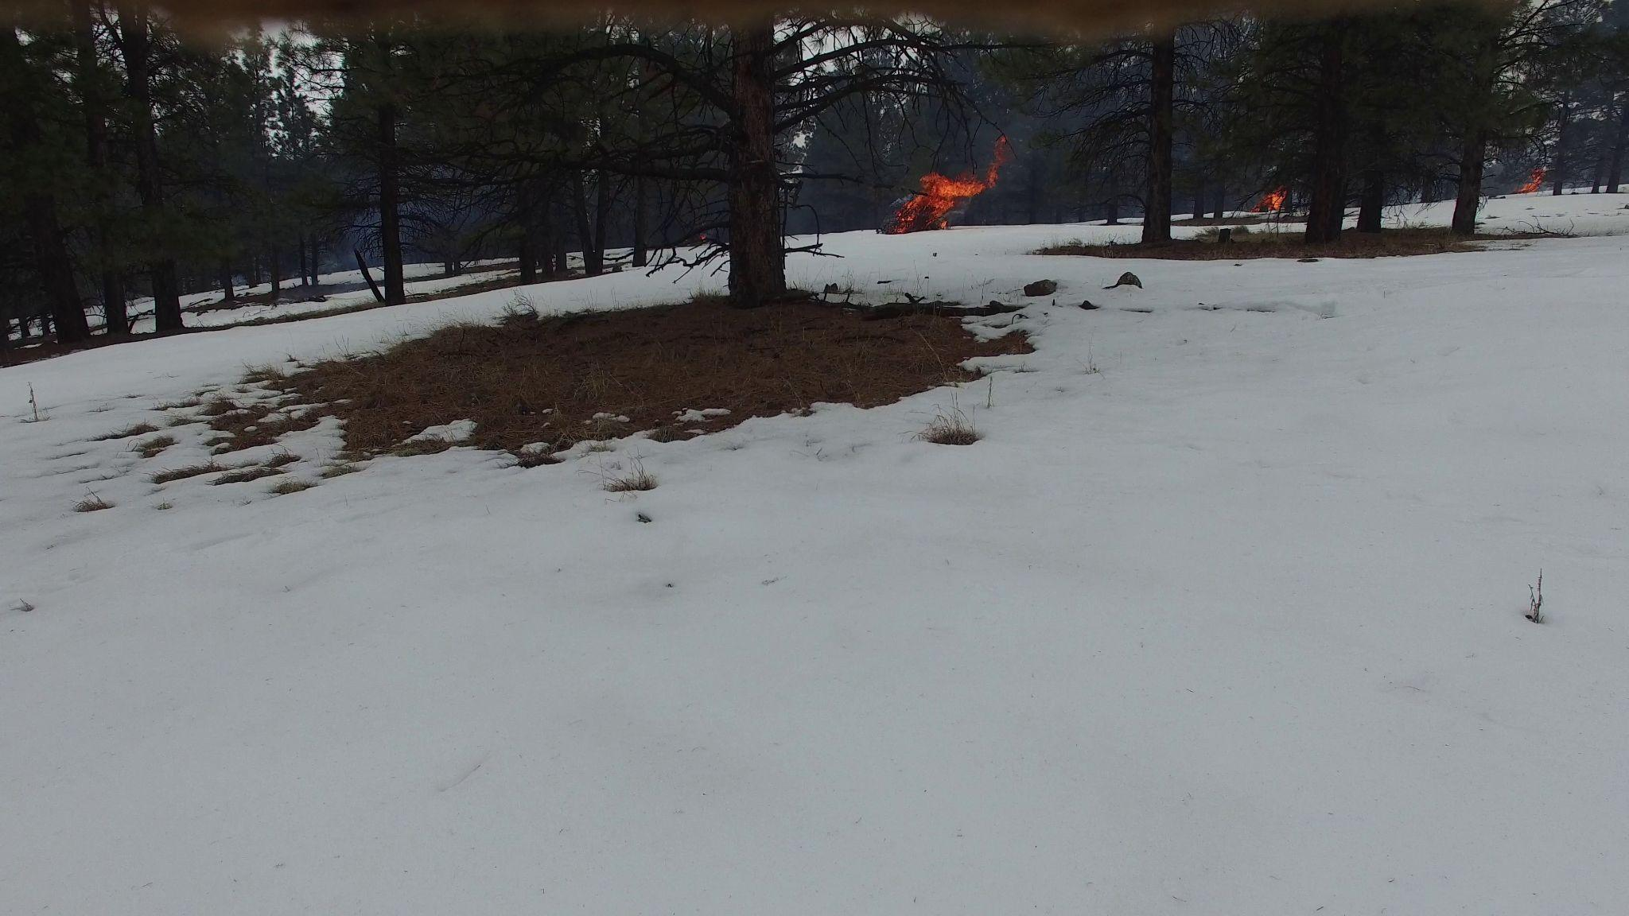
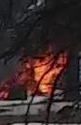
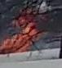
Dataset

Slide 14
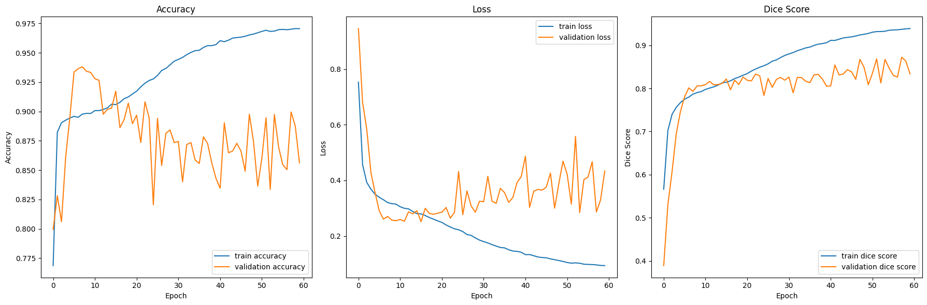
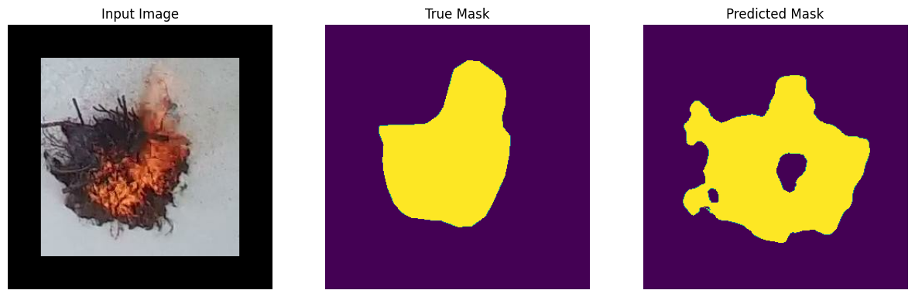
Results 60 epoch lr 0.00001

Slide 15
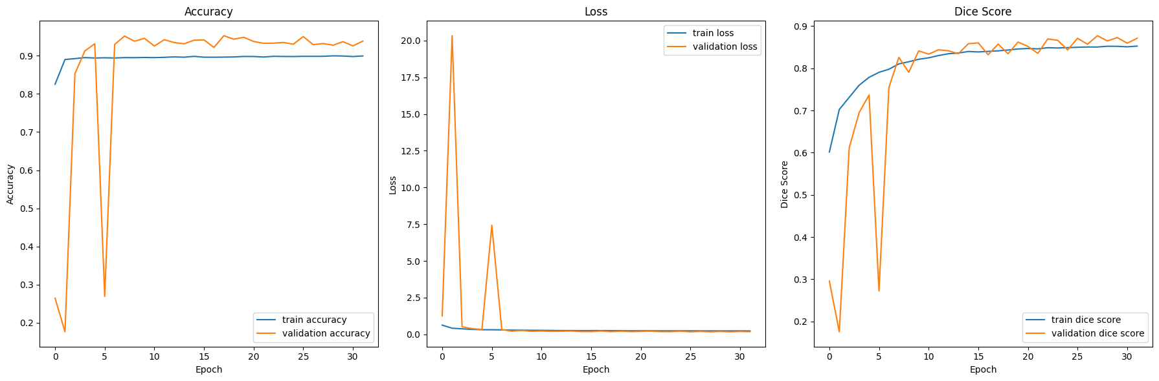
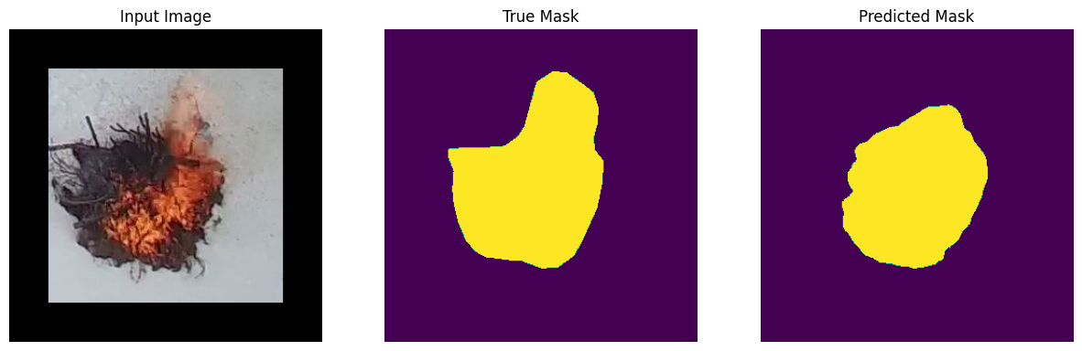
Results 40 epoch lr 0.0001

Slide 16
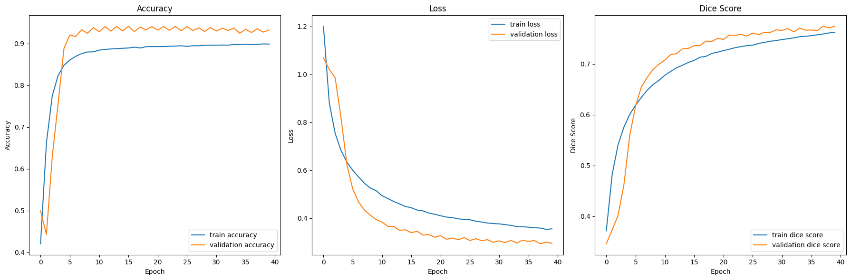
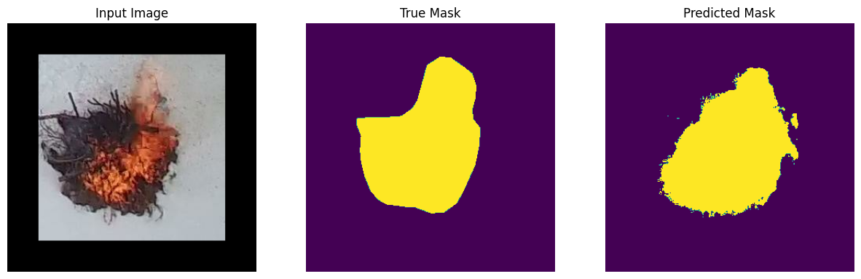
Results 40 epoch lr 0.000001

Slide 17
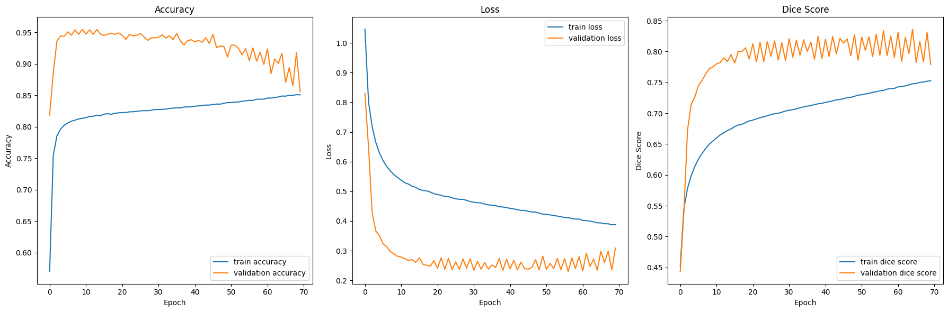
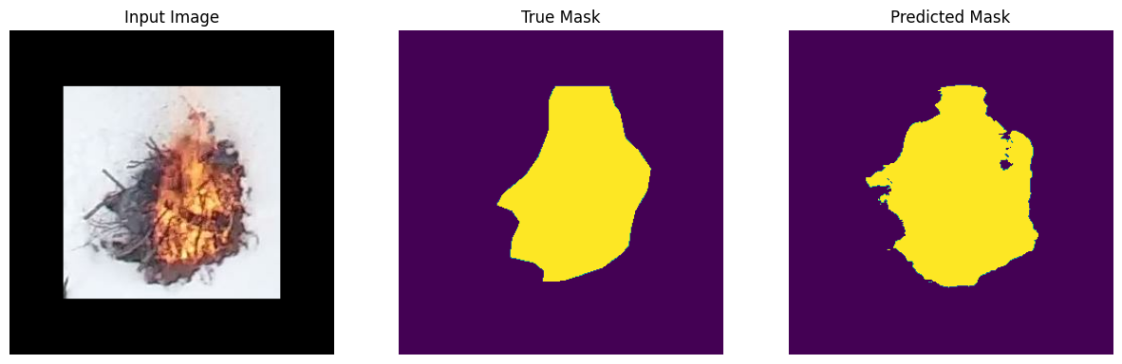
Results 70 epoch lr 0.000001

Slide 18
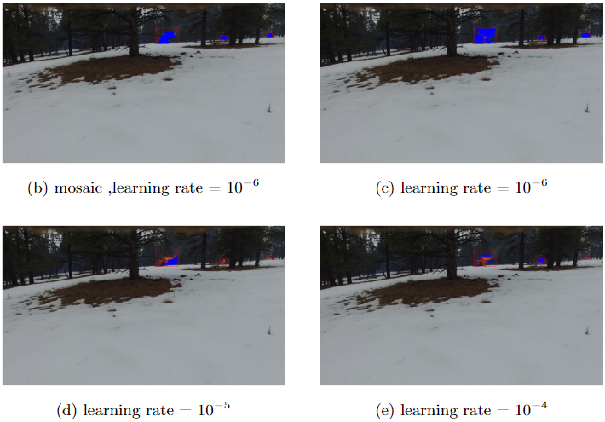
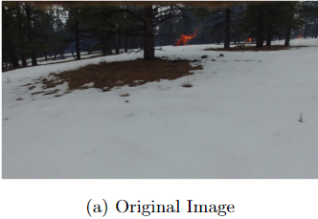
Result - Example

Slide 19
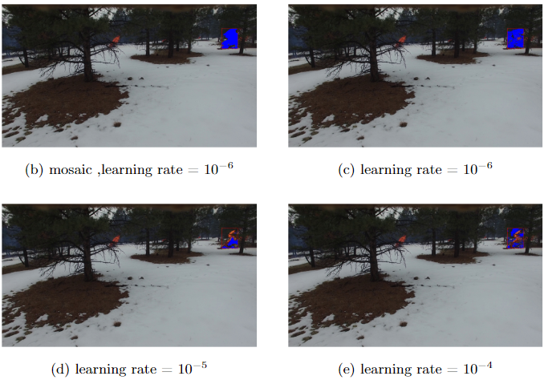
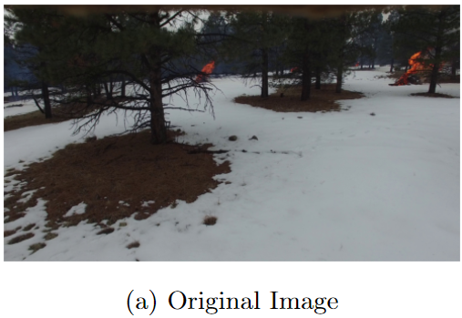
Result - Example

Slide 20

Demo

Slide 21
Conclusions
Exploring new sets of hyperparameters for segmentation of wildfire with high accuracy.
Using the “Sparse Categorical Cross-Entropy” loss function on a data that is not well balanced could significantly improve the learning.
The quality of ground truth masks significantly impacts segmentation accuracy, imprecise masks can lead to model confusion and reduced performance.

Slide 22
Thank
You

